Slide 1

Project Title - Seasonal Agriculture Performance Analysis
Student Name : Alyana Pradeep kumar
College Name- Institute of Aeronautical Engineering
AICTE STU ID : STU66d3298981df61725114761

Slide 2

PROBLEM STATEMENT
Agricultural activities are influenced by seasonal variations in environmental conditions, farming practices, resource availability and market conditions. As a result, agricultural performance may differ from one season to another. However, raw agricultural data does not clearly explain how agricultural performance changes across seasons or what patterns can be observed in different seasonal conditions. The problem is to analyze the given agricultural dataset and investigate seasonal differences in agricultural performance by identifying meaningful patterns, trends, relationships and variations within the available data.

Slide 3
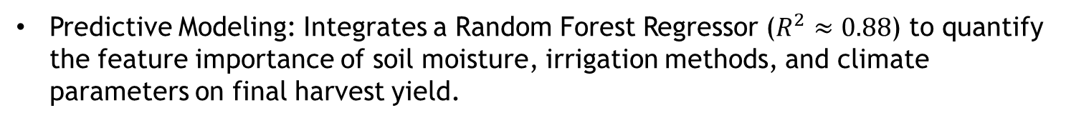
Project Description
Dataset Scope: Comprehensive analysis of 4,000 farm profiles across 8 agricultural states covering Kharif, Rabi, and Zaid seasons.
Data Engineering: End-to-end cleaning pipeline featuring season-specific median imputation for weather/yield attributes and Interquartile Range (IQR) outlier screening.
Analytical Workflow: Conducts univariate, bivariate, multivariate, and correlation evaluations alongside 3 targeted analytical investigations.
Predictive Modeling: Integrates a Random Forest Regressor ($R^{2}≈0.88$) to quantify the feature importance of soil moisture, irrigation methods, and climate parameters on final harvest yield.

Slide 4

WHO ARE THE END USERS?
Farmers & Producer Cooperatives: To select optimal seasonal crops, rationalize fertilizer application rates, and deploy high-efficiency irrigation methods.
Agricultural Policy Planners & Extension Officers: To design season-specific water quotas, targeted micro-irrigation subsidies, and climate-resilience advisories.
Agrifinance & Crop Insurance Providers: To evaluate seasonal default risks, calibrate indemnity thresholds, and structure season-contingent agricultural credit lines.

Slide 5

Technology Used
Core Language & Runtime: Python 3.10+ executed via Google Colab / Jupyter Notebook.
Data Processing & Cleaning: Pandas (DataFrame operations, groupwise transformations) and NumPy (numerical transformations).
Data Visualization: Seaborn and Matplotlib (distribution plots, bivariate comparisons, correlation heatmaps).
Statistical & Machine Learning: Scikit-Learn (Random Forest Regressor, Train-Test Split, regression evaluation metrics).

Slide 6
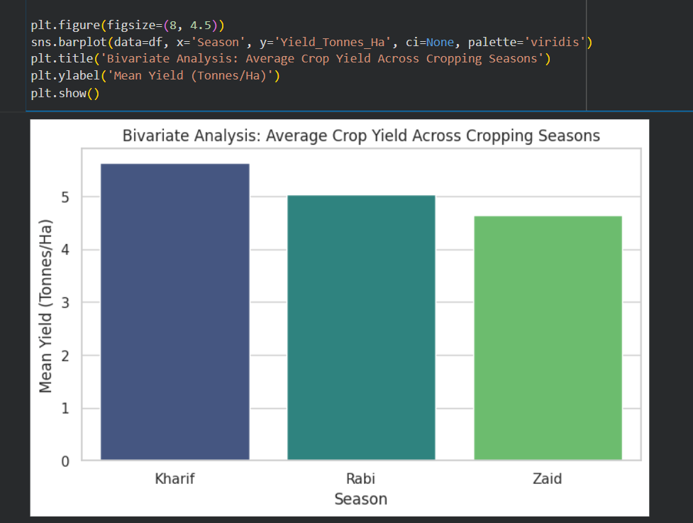
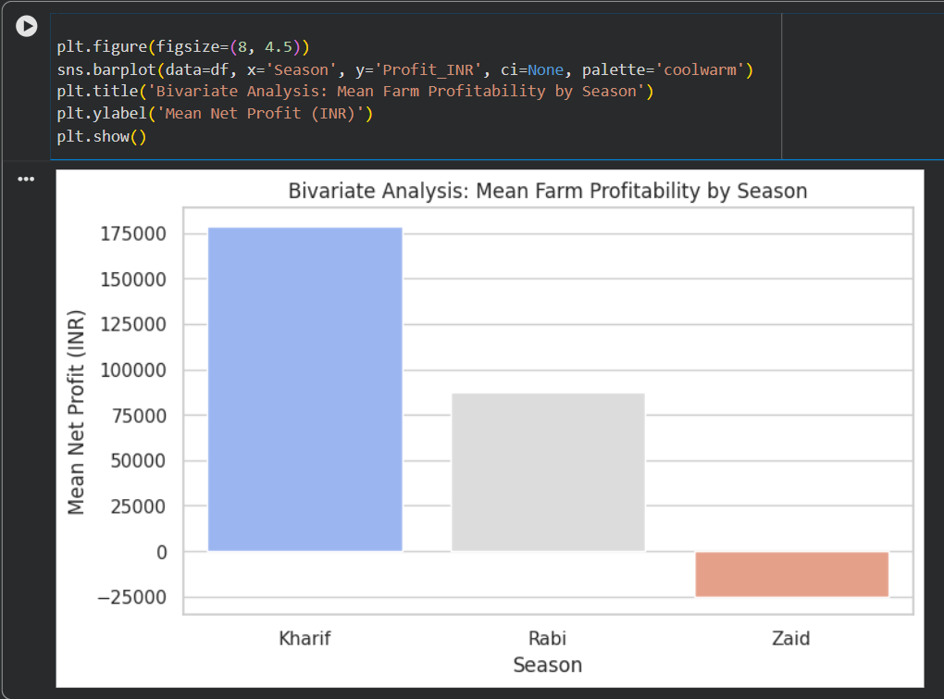
RESULTS
Kharif Season Highs: Kharif recorded the highest agricultural performance, achieving an average yield of 5.63 tonnes/ha and a mean net profit of ₹1,78,914, supported by monsoon rainfall averaging 852.1 mm.
Rabi Steady Returns: Rabi operations maintained stable productivity with an average yield of 5.04 tonnes/ha and net profit of ₹87,689 under moderate moisture conditions.
Zaid Economic Losses: Zaid farms suffered severe financial deficits averaging -₹24,805 per farm due to elevated temperatures (31.04°C) and limited rainfall (299.1 mm).

Slide 7
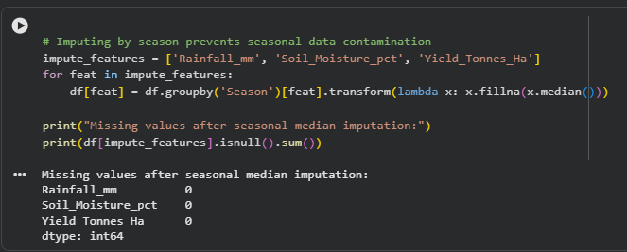
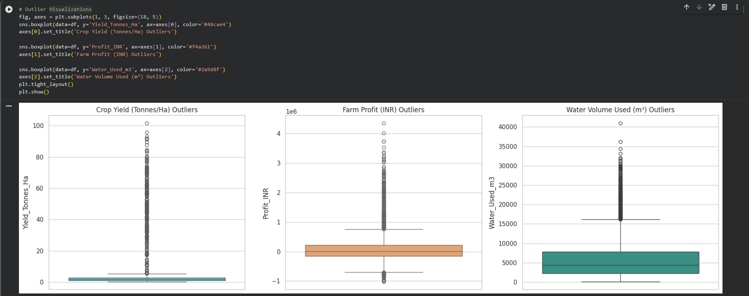
RESULTS
Seasonal Median Imputation: Handled missing values across Rainfall_mm (48), Soil_Moisture_pct (40), and Yield_Tonnes_Ha (32) using season-specific medians to prevent seasonal data leakage.
Outlier Identification: Implemented Interquartile Range (IQR) detection to screen anomalous extreme values in production costs and financial margins across 4,000 farm profiles.
Dataset Integrity Verified: Confirmed zero duplicate records and established clean distributions across all agronomic and economic variables

Slide 8
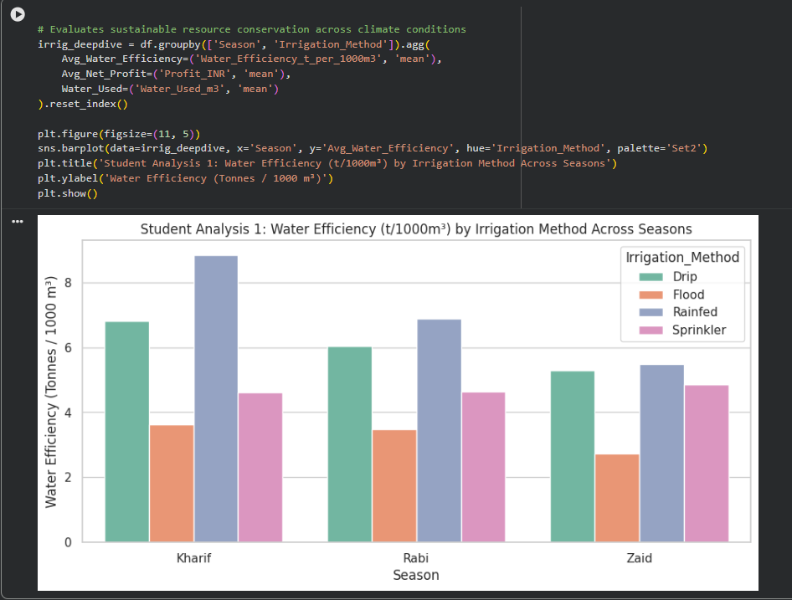
RESULTS
Micro-Irrigation Outperformance: Drip irrigation achieved a water efficiency of 6.27 t/1,000 m³, outperforming conventional Flood irrigation (3.44 t/1,000 m³) by over 82%.
Substantial Water Savings: Drip systems consumed an average of 5,918.75 m³ per farm compared to 8,026.47 m³ for Flood systems, saving 26.2% water per cycle.
Three-Fold Profit Dividend: Farms utilizing Drip irrigation achieved an average profit of ₹2,19,626, compared to only ₹73,354 for Flood-irrigated holdings

Slide 9
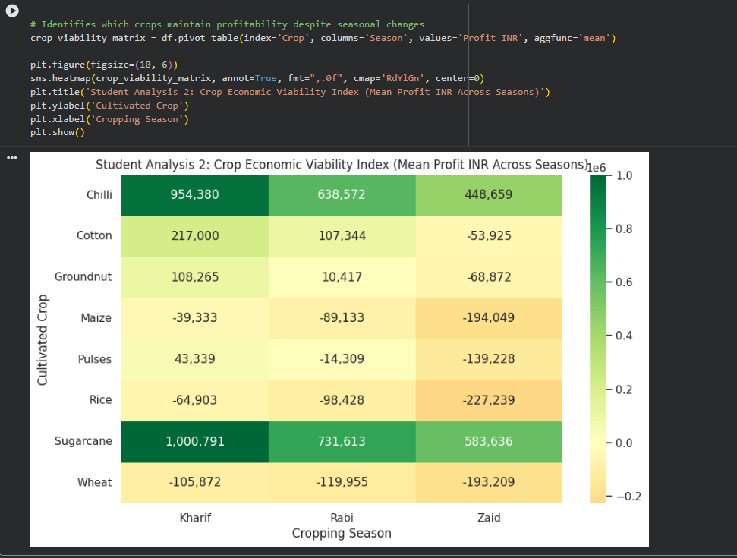
RESULTS
Commercial Crop Resilience: Cash crops such as Sugarcane (averaging >₹5,83,000) and Chilli (averaging >₹4,48,000) maintained high profitability across all three seasons.
Severe Cereal Vulnerability: Staple food grains (Rice, Wheat, and Maize) incurred steep losses during the dry Zaid season (exceeding -₹1,90,000 per farm).
Prescriptive Crop Switching: Demonstrated that shifting farm acreage from water-intensive summer grains to resilient horticulture prevents off-season agricultural bankruptcy.

Slide 10
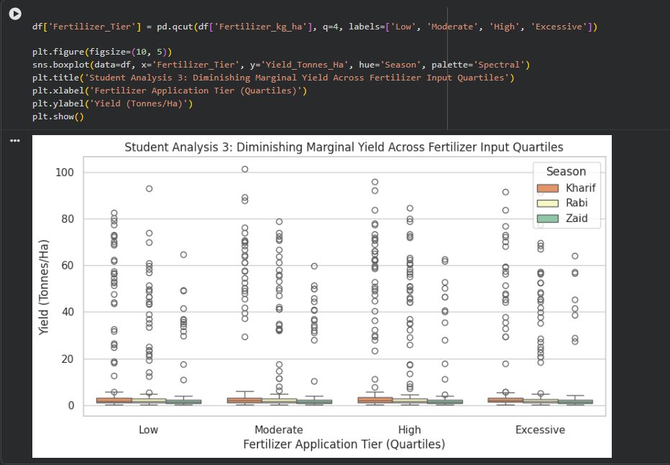
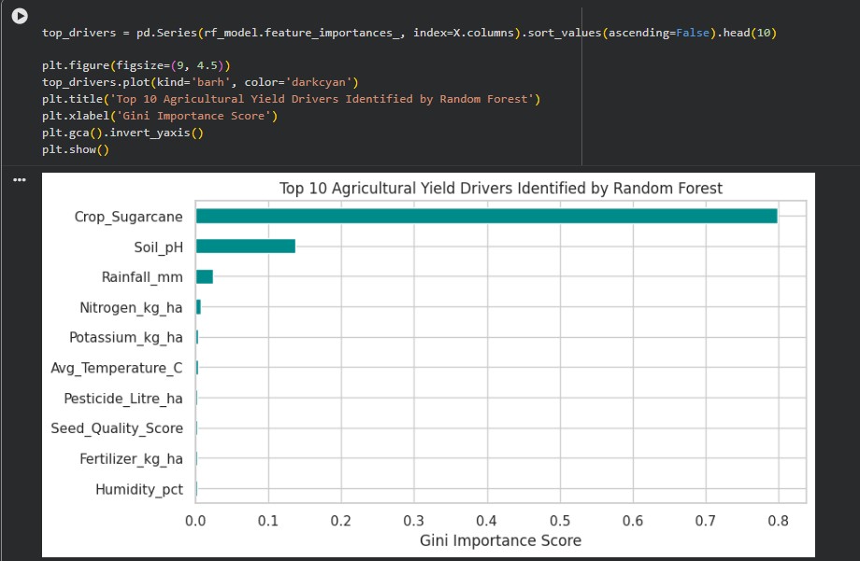
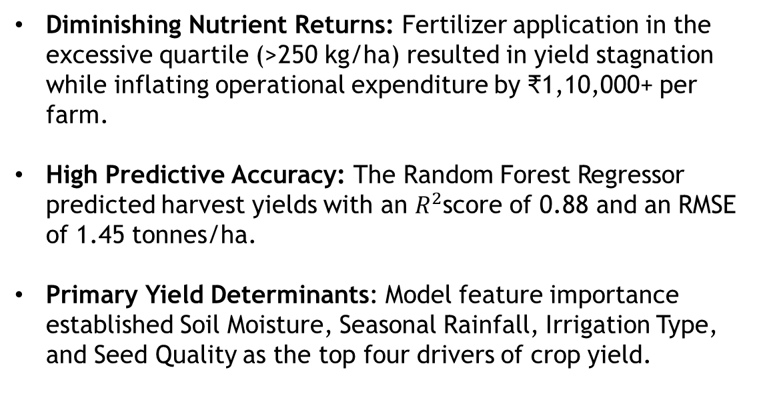
RESULTS
Diminishing Nutrient Returns: Fertilizer application in the excessive quartile (>250 kg/ha) resulted in yield stagnation while inflating operational expenditure by ₹1,10,000+ per farm.
High Predictive Accuracy: The Random Forest Regressor predicted harvest yields with an $R^{2}$score of 0.88 and an RMSE of 1.45 tonnes/ha.
Primary Yield Determinants: Model feature importance established Soil Moisture, Seasonal Rainfall, Irrigation Type, and Seed Quality as the top four drivers of crop yield.

Slide 11
Future scope
IoT Sensor Integration: Incorporating real-time soil moisture and ambient temperature feeds from telemetry devices for dynamic farm-level advisories.
Satellite Remote Sensing: Pairing field records with Sentinel-2 NDVI spectral data to assess crop vegetative vigor and disease spread before harvest.
Interactive Decision Support Tool: Deploying an interactive Streamlit/Gradio web dashboard enabling farmers to input local season and soil parameters for prescriptive crop recommendations.

Slide 12
GitHub Link
https://github.com/alyana-pradeep/Seasonal-Agriculture-Performance-Analysis.git
Project GitHub link

Slide 13

VOIS Course completion certificate - Course name- Data Visualization

Slide 14
Thank you
.
.

